Slide 1
Lecture 24: More Advanced Architectures
Different architectures
Two degrees-of-freedom control
Feedforward control
Addressing multiple inputs
Addressing complexity with multiple loops
More design with MATLAB

Slide 2
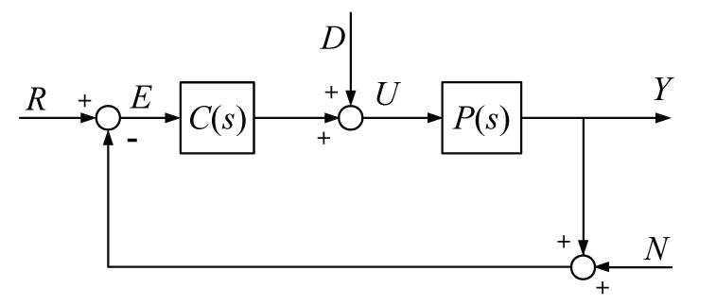
Different Architectures
So far we have primarily considered a negative feedback architecture with one loop and our controller in the forward path
Many other architectures exist

Slide 3
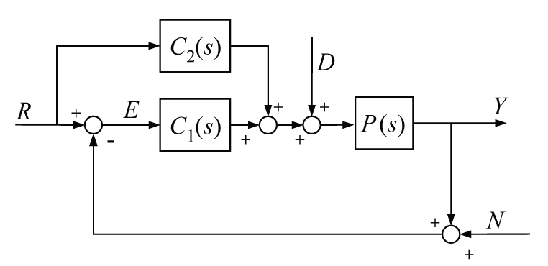
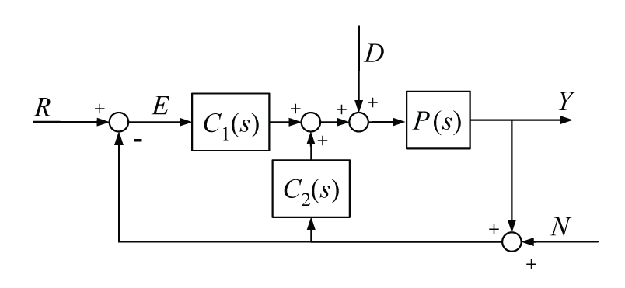
Two-Degrees-of-Freedom Control
Allows two of (G_{yr}, G_{yn}, G_{yd}) to be designed independently

Slide 4
Feedforward Compensator
Feedforward action can be used to correct for “known” disturbances
C(s) is designed by model inversion, can be static or dynamic
T_{L,est}
T_{L}
.
i_{a,des}
e_{a}
i_{a}
T
θ
e_{b}

Slide 5
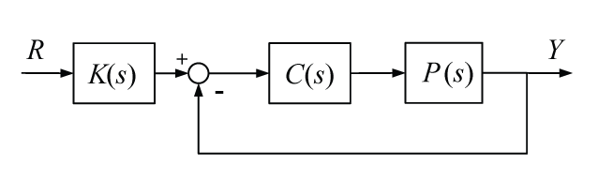
Feedforward Compensator
Pre-compensation can also be used to cancel undesired dynamics of the plant and to scale the steady-state output
Pre-compensator can speed response, but is susceptible to errors in the model and disturbances
“Error” is distorted by K(s) and errors in K(s) aren’t corrected by the feedback

Slide 6
Feedforward Compensator
Implementing the feedforward term as follows avoids these problems
Note, this is one of our 2-dof controllers

Slide 7
Multiple Inputs
We have primarily designed control for single input single output (SISO) systems
When we had multiple inputs, we could examine the response to each input separately if the system was linear
If inputs are coupled in a nonlinear manner, we can use heuristics to decouple them

Slide 8
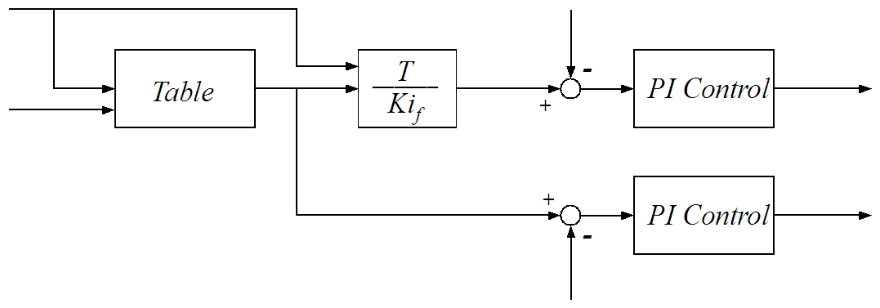
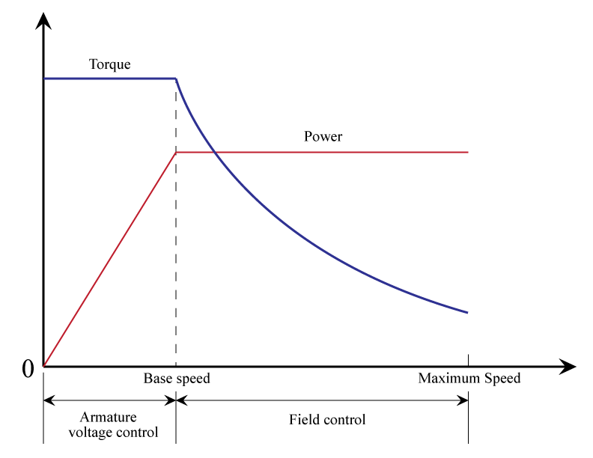
Example
Separately excited DC motor control
Control both armature current and magnetic field strength
T_{des}
i_{a}
i_{a,des}
e_{a}
ω
i_{f,des}
e_{f}
i_{f}

Slide 9
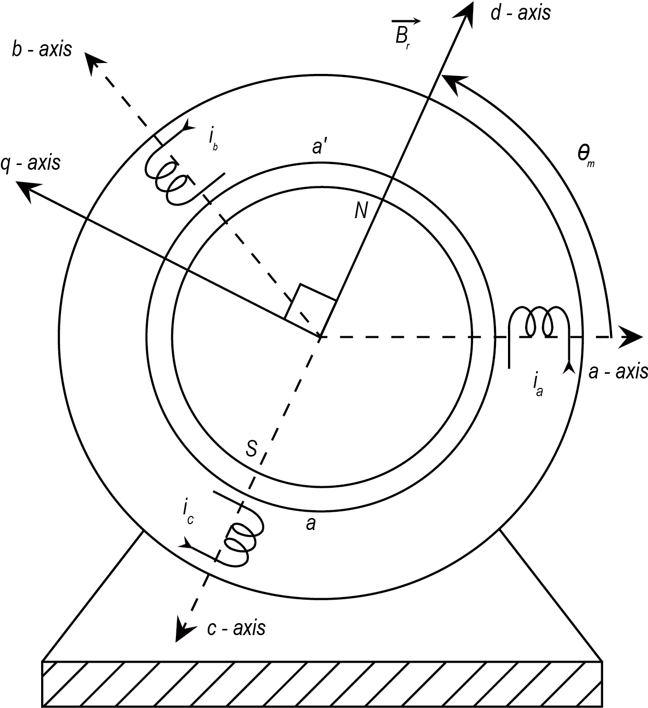
Example
Permanent magnet synchronous machine (traction motor) control often uses an approach called Vector Control or Field Orientation Control to emulate the previous case
Employs DQ modeling

Slide 10
Multiple Loops
Using nested controllers can help reduce the complexity of the design for higher-order systems if the dynamics can be de-coupled based on speed
Using a single controller can limit speed of response due to slow (dominant) dynamics

Slide 11
Multiple Loops
desired
speed
desired
torque
.
Approach:
Design control for the fast inner loop
Treat inner loop as static, then design control for slow outer loop
Can continue beyond two nested loops
i_{a}
T
θ
torque (current)
speed

Slide 12
Example
Section 8-7 of Mohan, Electric Drives
Step 1: Design Fast Inner Loop (the current loop)
Approach used: place zero of controller to cancel slow pole of the plant, then choose gain to achieve gain crossover frequency a decade or two below power electronics switching frequency
i_{a,des}
i_{a}

Slide 13
Example (cont)
System Parameter | Value
Ra | 2.0 Ω
La | 5.2 mH
J | 152x10-6 kg·m²
b | 0
Ke | 0.1 V/rad/s
K | 0.1 Nm/A

Slide 14
Example (cont)
Magnitude plot of
Desire K_{c} so that gain crossover frequency is one to two decades below switching frequency, in this case fs=200,000 rad/sec

Slide 15
Example (cont)
Controller for the current loop
Resulting open-loop magnitude plot

Slide 16
Example (cont)
Step 2: Treat inner loop as a static gain then design slow outer loop (speed loop)
current
loop
desired
speed
.
θ

Slide 17
Example (cont)
Since b=0,
Desire to place gain crossover frequency one decade below crossover of inner current loop
Desire to achieve reasonable phase margin, ≈ 60 degrees

Slide 18
Example (cont)
Will use SISO Design tool in MATLAB

